Slide 1
Omnia Markdown Accessibility Validator & Fixer
Joned Harun David
Date: 08/25/2026
Notes:
Good morning everyone, and thank you for joining me today to discuss my first month of learning at Dell. My name is Joned Harun David, and I'm excited to share my key learnings and insights with you. Over the past month, I've had the opportunity to dive into various concepts, processes, and tools, and I'm eager to share my experiences with you.

Slide 2
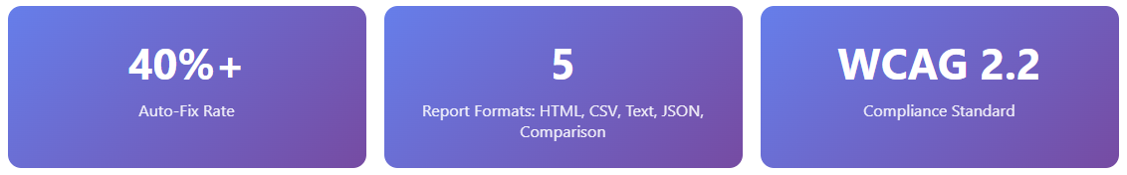
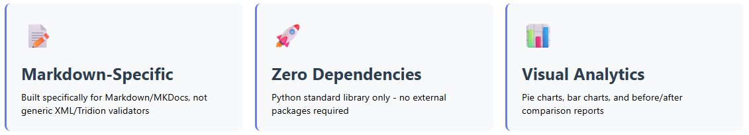
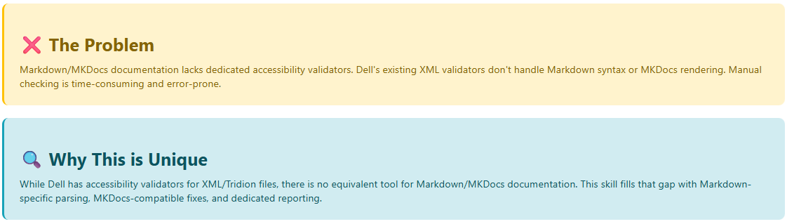
Omnia Accessibility Validator and Fixer for MKDocs
Notes:
Thank you so much for your time and patience through the first review.
I have taken all your individual feedbacks and I’ve prepared for this session based on that.
Vasanth is creating agents to generate content and it’s in pipeline. My vision is to contribute and see how I can streamline and optimize them.

Slide 3

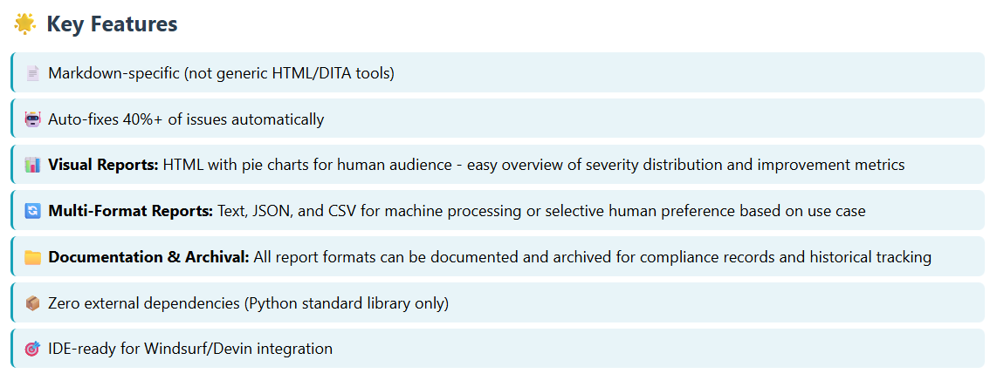
Omnia Accessibility Validator and Fixer for MKDocs

Slide 4
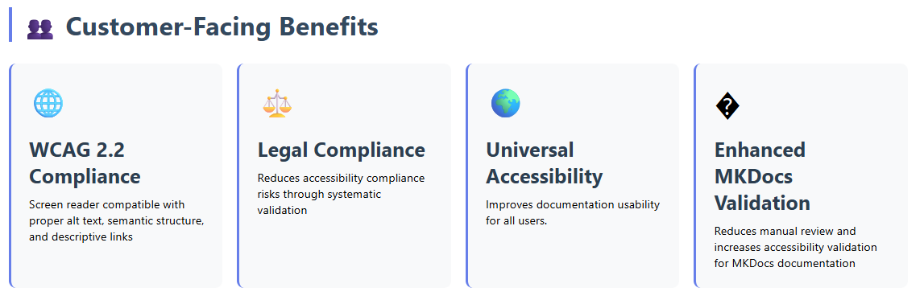
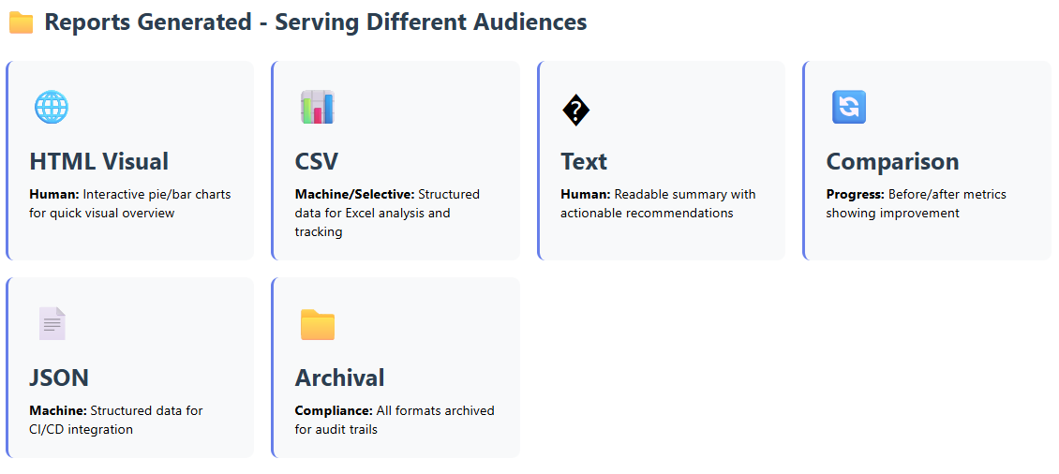
Omnia Accessibility Validator and Fixer for MKDocs
Notes:
Think of it like writing a complete blueprint for a house before laying a single brick. The spec becomes the single source of truth from which the code, tests, and documentation are all derived.
1. 📄 Documentation First
You write the "manual" — the requirements, rules, and design — before building the product. The planning and design phases are thoroughly fleshed out in text before any implementation begins.
2. 📐 Specs as the Source of Truth
Code is treated as a byproduct of the spec, not the other way around. If requirements change, the spec is updated first, and the new code is then generated or validated against it.
3. 🤖 Machine and Human Readable
Specs are often written in Markdown or standard schemas (like OpenAPI/Swagger). They must be perfectly understandable to:
Business stakeholders
Developers
AI agents
4. 📜 The "Constitution"
Modern SDD workflows often include a project "constitution" — a master document containing non-negotiable rules such as:
Coding standards
Architectural guidelines
UI/UX rules
AI agents must adhere to this constitution when turning the spec into code.

Slide 5
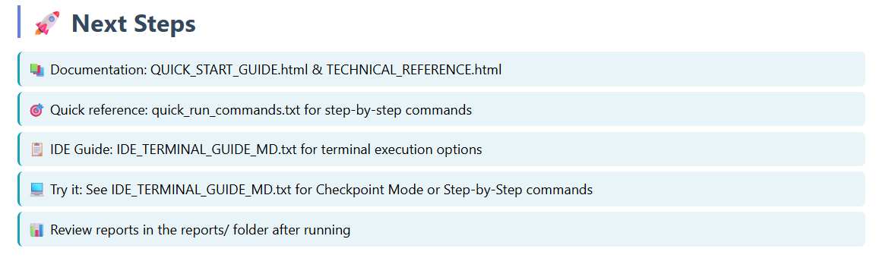
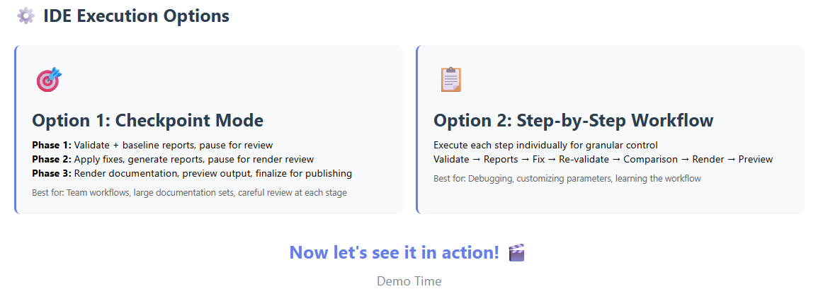
Omnia Accessibility Validator and Fixer for MKDocs
Notes:
Because modern software development is increasingly driven by natural language prompts, the role of Content Engineers, Information Developers, and Technical Writers is undergoing a major transformation. In SDD, writing is essentially coding, making technical communication skills more critical than ever.
✅ "Shifting Left" — Moving to the Front of the Line
Traditionally, technical writers document a product at the end of the development lifecycle. In SDD, Information Developers are brought in at the very beginning to help architect, write, and structure the specifications that actually generate the product.
✅ Writing for Dual Audiences (AI and Humans)
Content Engineers are experts in structure, clarity, and consistency. In SDD, they must craft specifications that are:
Unambiguous enough that an AI coding agent won't hallucinate or make bad assumptions.
Readable enough for human product managers and developers to review and approve.
✅ Managing "Living" Documentation
In the past, requirement documents often hosted on Tridion docs after a project launched. In SDD, specs are the living DNA of the application. Information Developers maintain and version-control these documents continuously, because updating the spec is how you update the software.
✅ Prompt Engineering as Technical Writing
Technical writers in SDD workflows often act as high-level prompt engineers. They help:
Build the system's "constitution."
Break complex requirements into clear, atomic "work packages" that an AI agent can execute without losing context.
In short: Spec-Driven Development transforms the Information Developer from an after-the-fact historian into a core architect of the software's logic and behavior. It puts structured, clear writing at the very heart of how modern software is built.

